Slide 1
Gompf’s Pocket Refs™
LUNG

Slide 2
Ground Glass Opacities in the Immunocompromised
ACUTE
Pulmonary edema
Diffuse alveolar hemorrhage
PCP (if HIV+: 90%; 95% specificity)
– 30% cystic
Drug reaction (lower
lung zones)
Lymphoma
CHRONIC
+/- nodules/fibrosis
• Bronchiolitis-assoc Interstitial Lung Disease
• Cryptogenic Organizing Pneumonia (peripheral, patchy)
• sarcoid

Slide 3
Nodular pneumonia in the Immunocompromised
Random, sharp borders
Fungal
TB
Mets
With fibrosis/ground glass/peripheral zone
Cryptogenic organizing pneumonia

Slide 4
Tree-in-bud bronchiolitis
TB/Non-tuberculous mycobacteria
RSV
Adenovirus
Mycoplasma
Aspergillus in immunocompromised

Slide 5
Cryptogenic Organizing Pneumonia (COP)
Nonproductive cough,DOE
Flu-like illness
BAL foamy MØs, open biospy
Excessive small airways granulation tissue →intraluminal plugs in alveoli/bronchioles
Post infectious, drug, connective tissue disease, hypersensitivity
Prednisone1.5mg/k/dQD (solumedrol125mg Q6H x 3-5 days if rapid progression) x 4-8 wks, taper to 0.5mg/k/d over 4-6 wks, then to zero over 6 mos if stable
Cyclophosphamide if no response

Slide 6
Diffuse alveolar hemorrhage (DAH)
Progressive SOB, hypoxia, cough, diffuse consolidation over 1-7 days
BAL fluid progressively bloodier with each lavage
HSCT: 60-d survival 16% 26% with steroids
– Methylprednisolone 500mg IV BID x 3 days, then reduce by 50% every 3 days until off
Associations: Vaping/vitamin E acetate, age>40, vasculitides, autoimmune diseases, solid malignancies, severe mucositis, GVHD, WBC recovery post chemotherapy, renal insufficiency
Infection-associated: ARDS, flu, Hantavirus, dengue, CMV; Aspergillus/Mucor; Mycoplasma, TB, Leptospirosis, Legionella, Strongyloides stercoralis hyperinfection; any severe pneumonia with diffuse alveolar damage

Slide 7
RISK FOR FUNGI in CANCER PATIENTS
HIGH ANC <500, >5 wk/35d ANC <100, >3 wk/21d GVHDz AlloBMT unmatch/Ctrop• Prednis ≥80mg/d, >7d Prednis≥140mg/d, >14d HiDAC, Fludarabine? | HIGH INTERMEDIATE AML Total Body Irradiation AlloBMT sib/match ANC 100-500 3-5wks LOW INTERMED ANC 100-500 <3wks Older age Central line

Slide 8
+PPD 5 units (0.1mL) tuberculin injected ID
Measure induration at 48- 72hr (NOT redness) -earlier reaction is due to PPD additives, not TB -elderly may need 2 PPDs 1-2 weeks apart (booster phenomenon; 1st PPD may not react & be false -; subsequent PPDs may falsely suggest new conversion) | 5+ mm: HIV+ or risk factors Recent contact with TB New PPD conversion w/i 2 yrs Fibrotic /pleural changes on CXR Organ/Marrow transplant Other immunosuppression 10+ mm: Recently from high-risk area IVDU Resident/staff congregate living Direct patient care staff AFB lab staff Silicosis DM, hematologic CA, ESRD, malnutrition, gastrectomy 15+ mm: Everyone else

Slide 9
+PPD 5 units (0.1mL) tuberculin injected ID
CHECK PA/LAT CXR: 1. If NORMAL or shows HEALED primary TB (calcified granuloma, pleural thickening, upper lobe scarring), and risk not > benefit, treat as below. [If risk of INH > benefit, (e.g. liver disease) may opt for annual CXR followup.] 2. If CXR + infiltrates, cavitations, hilar adenopathy, effusions, or nodules, AND the patient is symptomatic or immunosuppressed or HIV+ ADMIT to R/O ACTIVE TB. 3. Check HIV antibody. | TREATMENT: INH 300mg PO QD + B6 50mg PO QD x 9 months (12 if HIV+ or immunosuppressed). Alt: DOT with Rifampin 600mg PO QD x 4 months if INH not tolerated -Monitor hepatic transaminases at baseline and q28d; -D/c rx if transaminases exceed 5x upper limit of normal, or symptoms/signs of hepatitis occur at any time. -At least q28d, assess adherence & for signs/symptoms of hepatitis or active TB. -Advise abstinence from EtOH during INH therapy.

Slide 10
Active Pulmonary TB: Prolonged cough ≥3 weeks Hemoptysis Chest pain Drenching night sweats Fever Fatigue Loss of appetite Unexplained weight loss | Extrapulmonary TB: Hematuria (renal TB) Headache/Confusion/Di-plopia (TB meningitis) Back pain (vertebral, Pott’s disease) Hoarseness (laryngeal - HIGHLY CONTAGIOUS!!) Night sweats, fever Fatigue Loss of appetite Unexplained weight loss

Slide 11
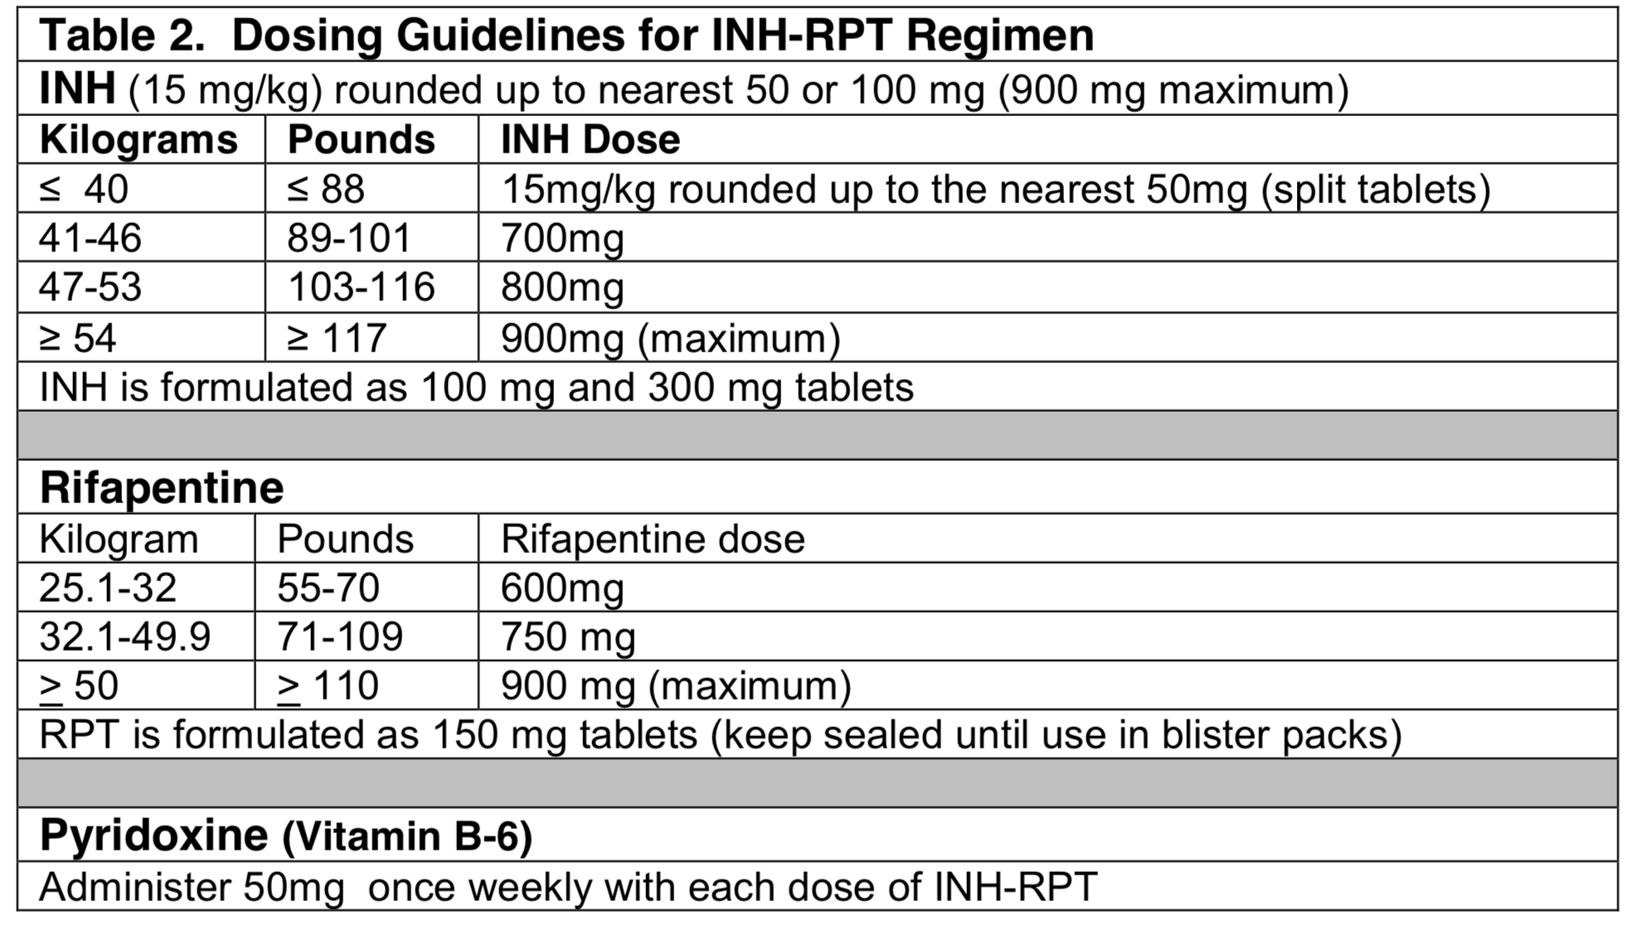
Treating latent TB
1. Rifampin 600mg/d X 12 weeks (best tolerated) 3. INH + rifapentine x 12 weeks (few doses→least tolerated): | 2. INH 300mg/day + B6 50mg/d x 6-9 months (no ethanol!)

